Slide 1


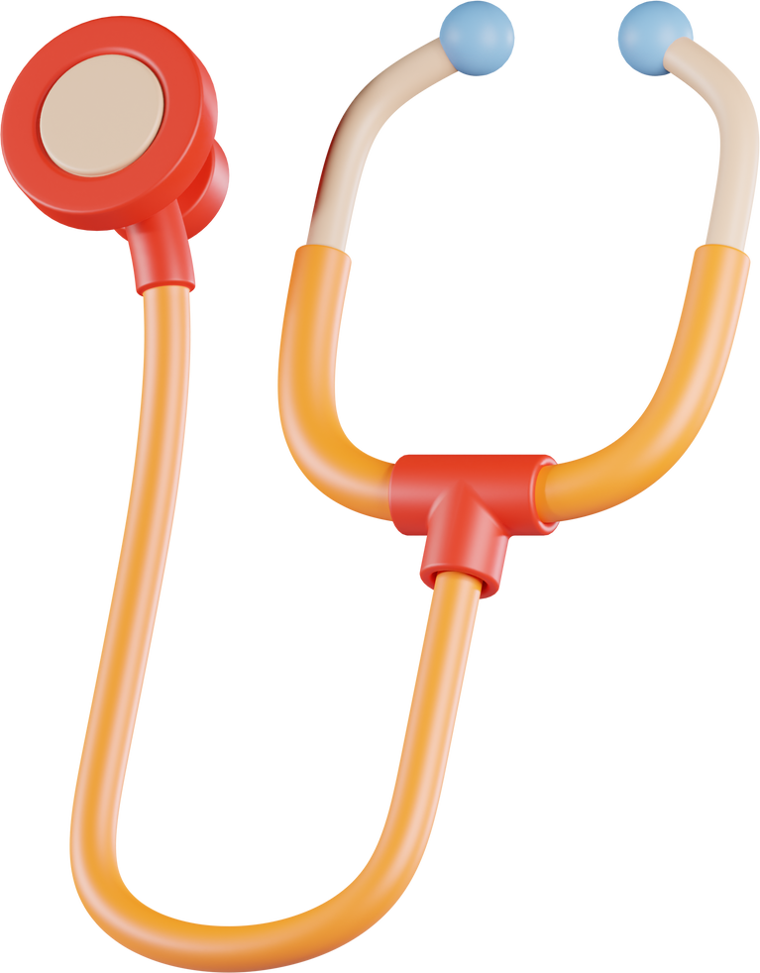
2-AXIS SELF-STABILIZING SPOON
ASSISTING PEOPLE WITH PARKINSON’S DISEASE
Presented by:
TEAM: WeMakeIt
Hiran Dharmapala
Nimesha Nanayakkara
Lasindu Viduranga
University of Sri Jayewardenepura, Sri Lanka

Slide 2


The Challenge of Parkinson’s Tremors
Parkinson’s Disease affects millions, leading to uncontrollable hand tremors.
Tremors make basic tasks like eating very difficult.
OUR GOAL: HELP INDIVIDUALS EAT WITH DIGNITY AND LESS FRUSTRATION.

Slide 3
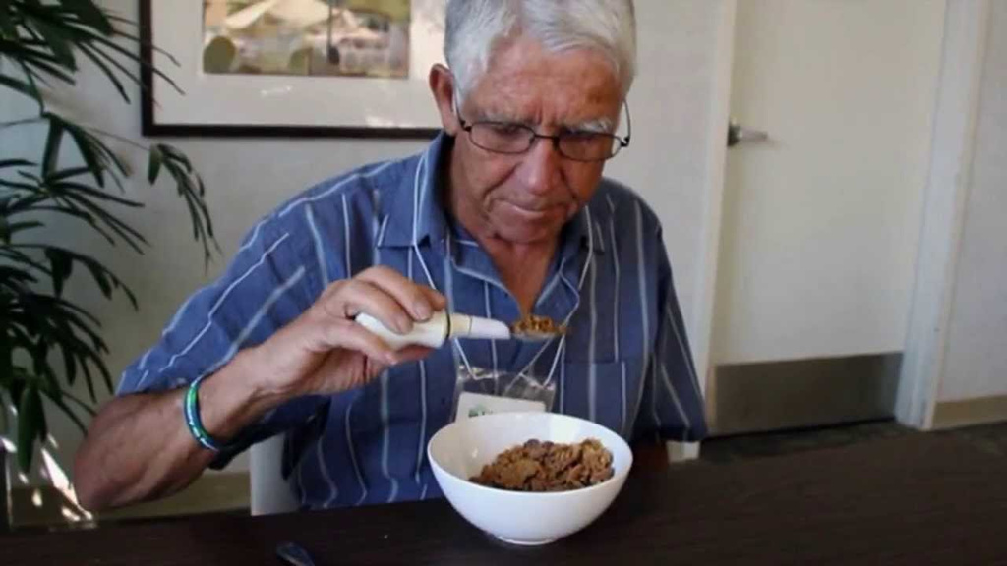

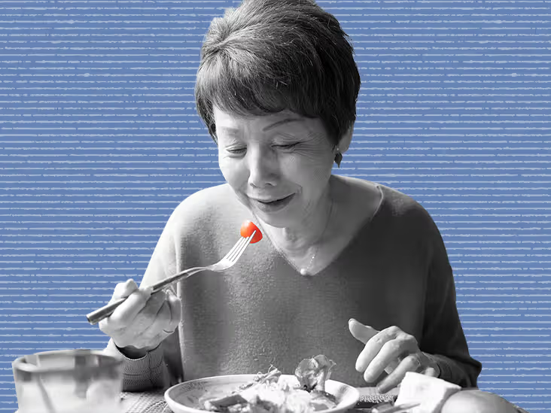
OUR ASSISTIVE INNOVATION
1
A 2-axis self-stabilizing spoon that detects hand tremors.
2
Automatically counters motion to reduce food spillage.
3
Affordable, compact, and customizable for real-life use.

Slide 4
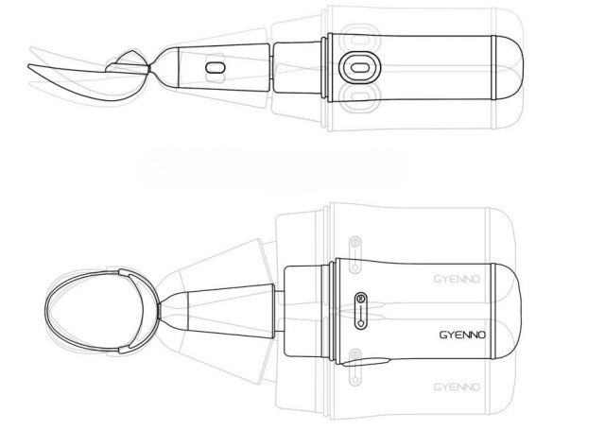
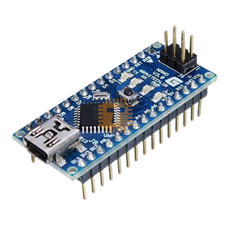
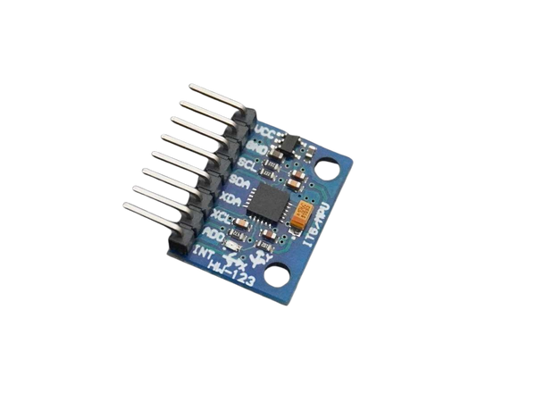
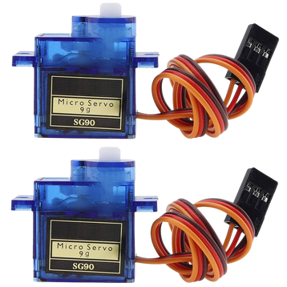
Component List & Working Principle
COMPONENTS:
WORKING PRINCIPLE:
Arduino Nano
MPU6050 (Gyroscope + Accelerometer)
2 × SG90 Servo Motors
3D Spoon Structure
2 × 3.7 V 800mAh Lipo Batteries + Power Circuit
MPU6050 tracks hand motion (pitch and roll).
Arduino processes the data with filtering.
Servos move the spoon in opposite directions to stabilize it.
Arduino Nano
MPU6050 (Gyroscope + Accelerometer)
2 × SG90 Servo Motors

Slide 5
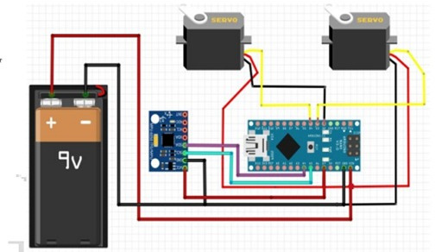
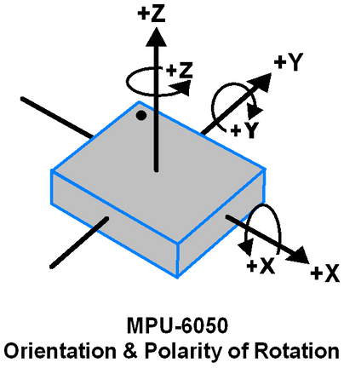
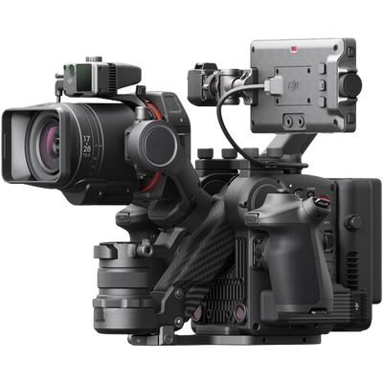
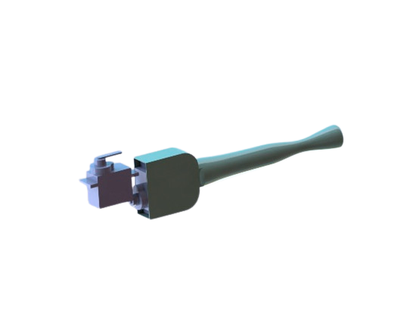
The Science Behind It
COMPLEMENTARY FILTER
ROTATION THEORY
CIRCUIT DIAGRAM
Angle = (1 - α) * Accel + α * Gyro
Avoids gimbal lock.
This circuit connects an Arduino Nano to an MPU6050 sensor and two servo motors, powered by 2 × 3.7V 800mAh Lipo Batteries. The MPU6050 provides motion data, while the servos respond based on sensor input. Ideal for balance or motion-controlled projects.
MECHANICAL ISOLATION:
Designed to isolate spoon from hand motion using 2-axis articulation

Slide 6


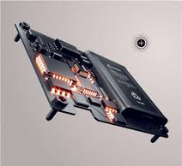
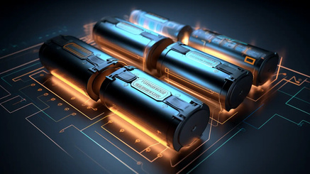
Final Overview
Provides tremor compensation using real-time feedback.
Improves quality of life during meals.
Simple electronics + 3D design = practical, low-cost solution.
.
Future plans: Sleeker design, faster motors, rechargeable battery.

Slide 7




Overcoming a Major Obstacle
SOLUTION
CHALLENGE
Implemented a complementary filter to smooth sensor readings,
ensuring stable and responsive spoon motion.
Sudden hand jerks caused servo overshoot and instability.

Slide 8


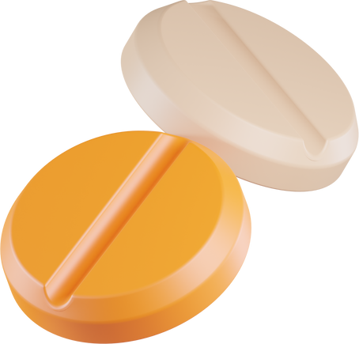
To enhance the design, we plan to:
Replace SG90 servos with MG90S for faster response.
Explore DC or stepper motors for precision.
Reduce the size for better comfort.
Switch from a bulky 3.7V 800mAh Lipo Battery to a more light weight and small one, making the device user-friendly.

Slide 9
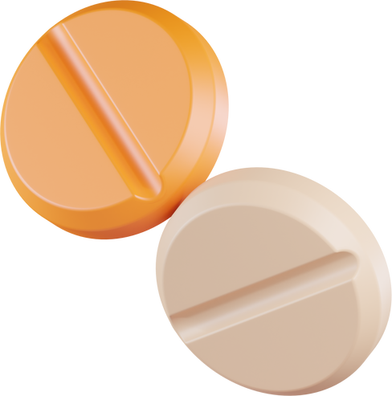
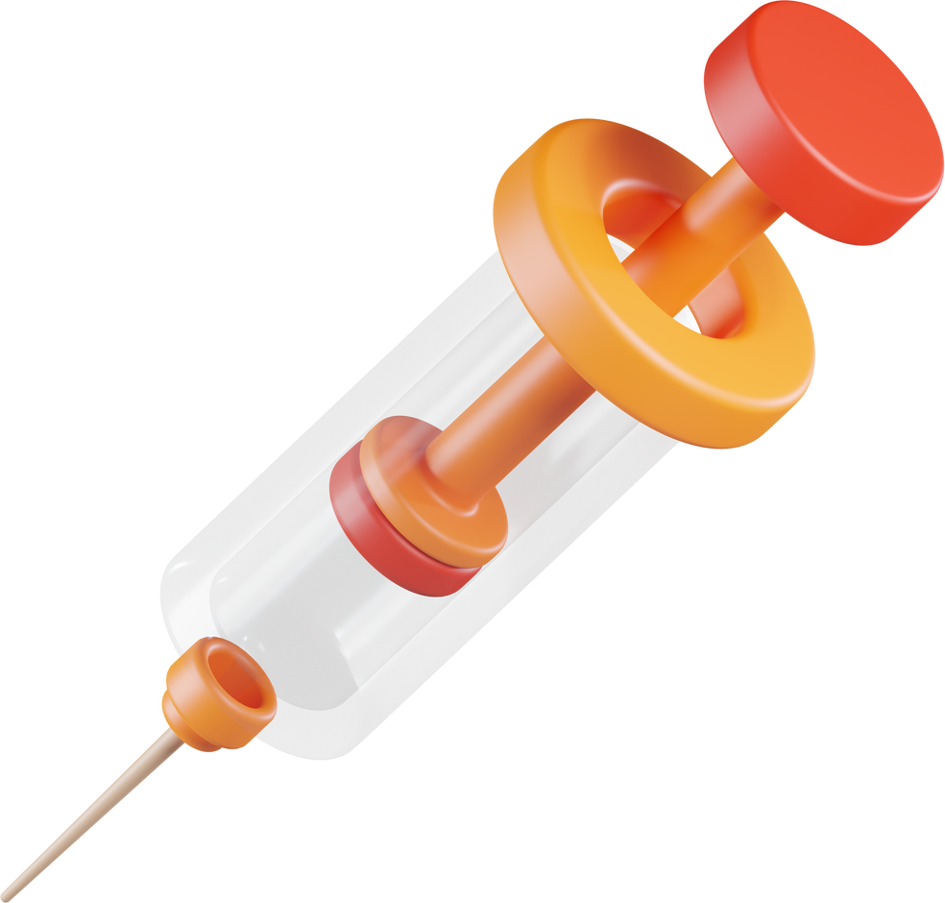
About Us
Hiran Dharmapala
Nimesha Nanayakkara
Lasindu Viduranga
Institution:
University of Sri Jayewardenepura, Sri Lanka
We’re proud to offer a low-cost innovation to assist those affected by Parkinson’s.
Engineering with purpose.
“WEMAKEIT”

